Slide 1

Café menu
BitCafe

Slide 2

Creators
Ivo Dimov
Kristian Neikov

Slide 3

The idea
We came up with the idea for a coffee shop, because it gives us more options to write code for.​

Slide 4

The functions
Our code contains five functions:​
-Create orders​
-Show orders​
-Update orders​
-Delete orders​
-Report​

Slide 5
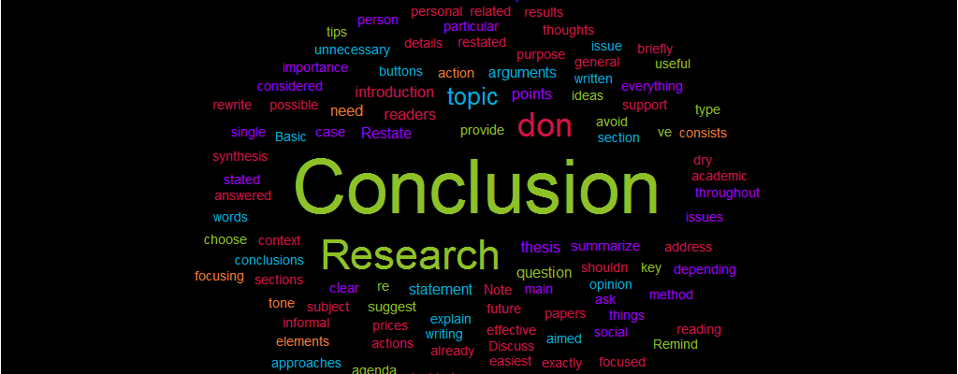
Conclusion​
For now, our code is successful and we are satisfied with it, but there is more to be modified and more features to be add .

Slide 6
Thank you for your attention!

